Slide 1
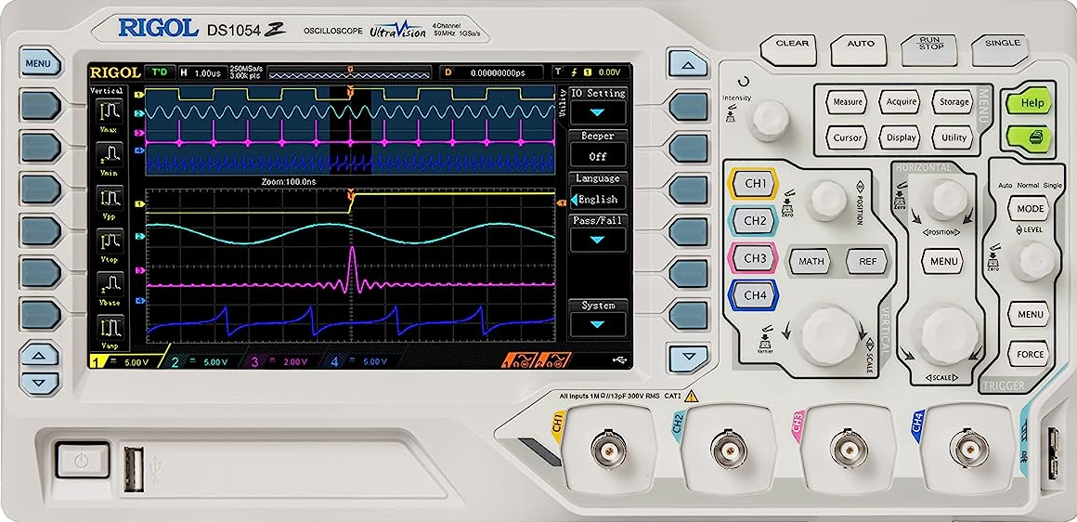
Intro to Oscilloscopes
July 2023

Slide 2
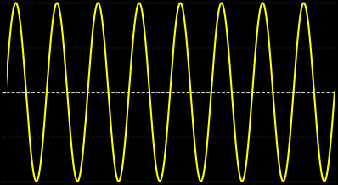
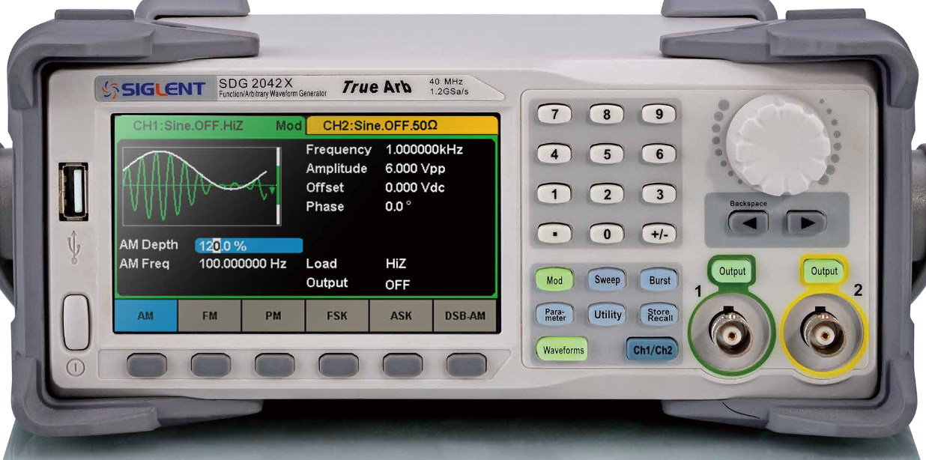
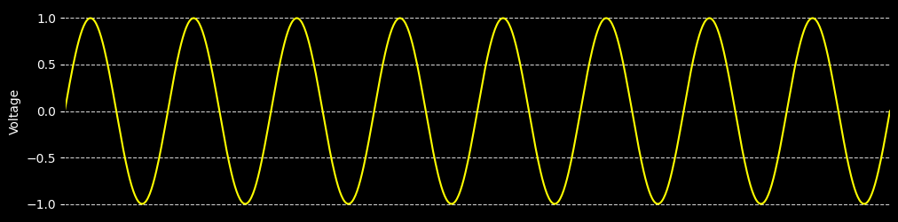
Play with these two knobs
Vertical Range
Horizontal Range

Slide 3
What’s happening?

Slide 4
Play with the position knobs
Vertical Position
Horizontal Position
Push knob in to “zero”

Slide 5
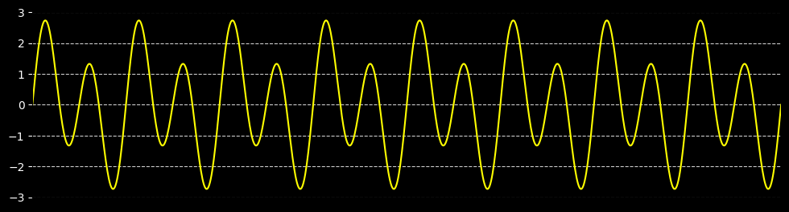
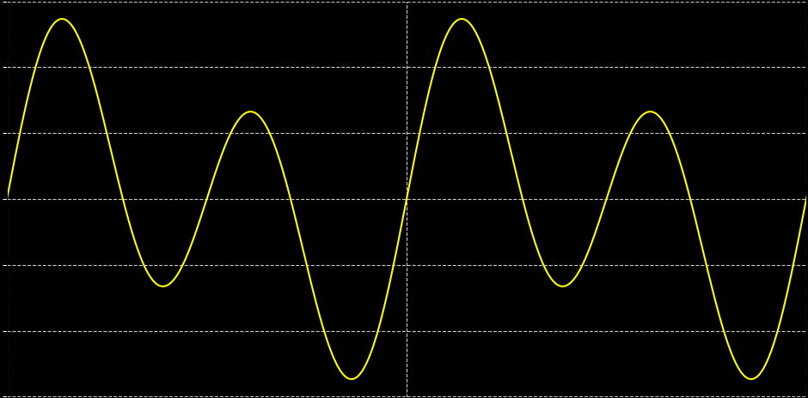
“Triggering” is often the tricky part
Scope chooses
a portion of the waveform to display, based on your settings

Slide 6
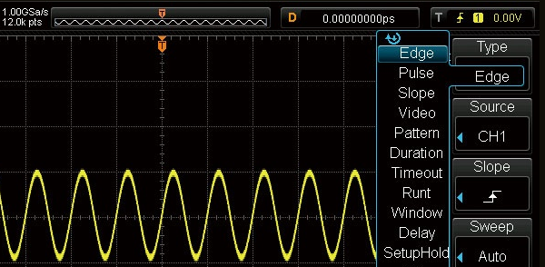
Adjust “Trigger Level”
0.5V
0.0V
-0.75V

Slide 7
Must decide when to “trigger”
Each arrow is a valid trigger point!

Slide 8
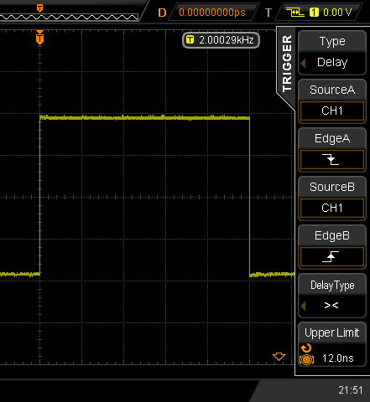
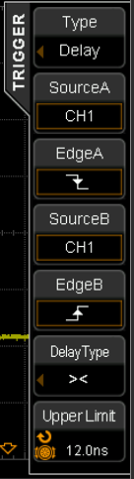
Adjust Trigger “Slope”
Rising Edge
Falling Edge

Slide 9
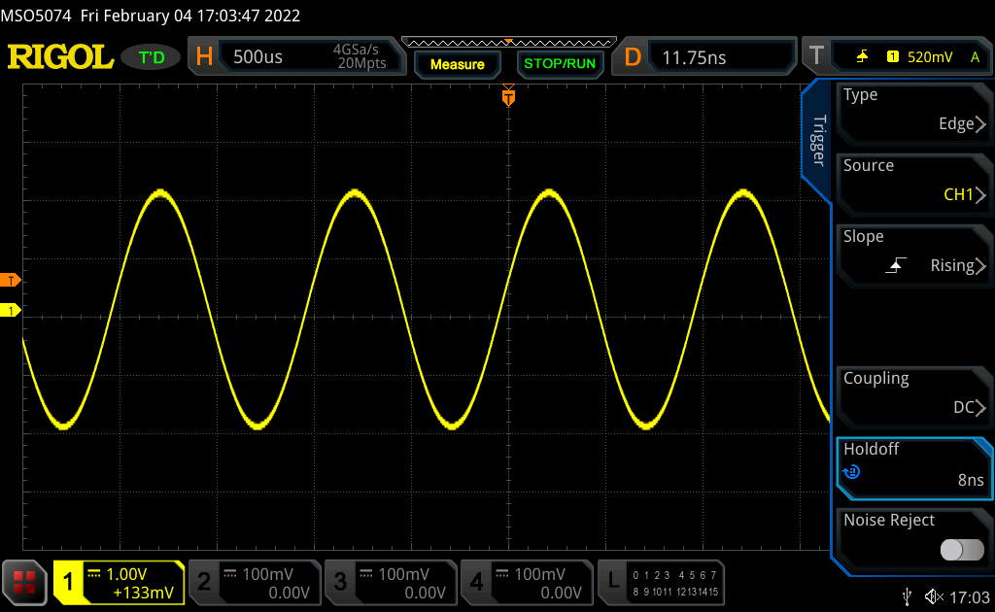
Trigger Setup

Slide 10
Typical adjustments to “see” a signal
Vertical Range/Position
Horizontal Range/Position
Trigger Level

Slide 11
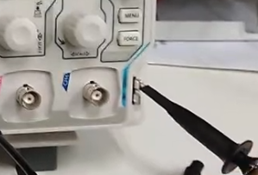
There’s no shame in mashing AUTO
AUTO
Can be hit or miss
Can also try calibration signal

Slide 12
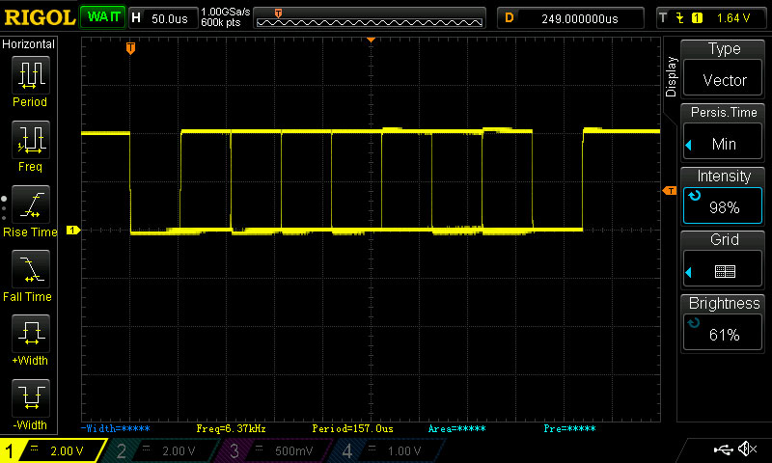
Multiple captures can be shown at one time
Display -> Persis. Time
Scopes have persistence, where a trace remains on the screen for a period of time. Sometimes this causes multiple traces to be displayed simultaneously.

Slide 13
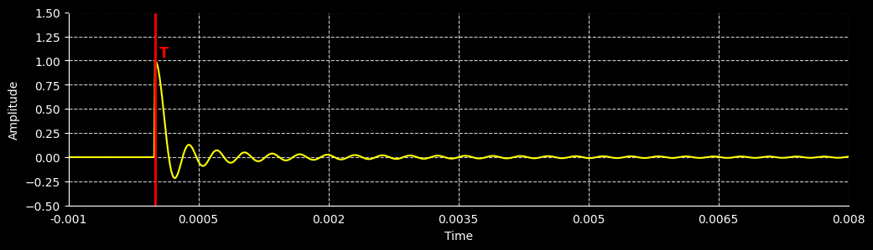
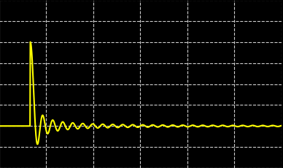
“Single Shot” capture can be handy

Slide 14
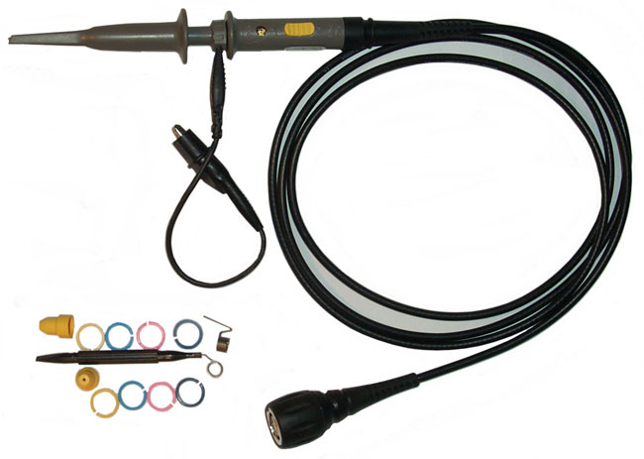
1x vs 10x Probe Setting
Use 10x unless the signal is buried in noise, then try 1x

Slide 15
Scope setting for 1x vs 10x Probe

Slide 16
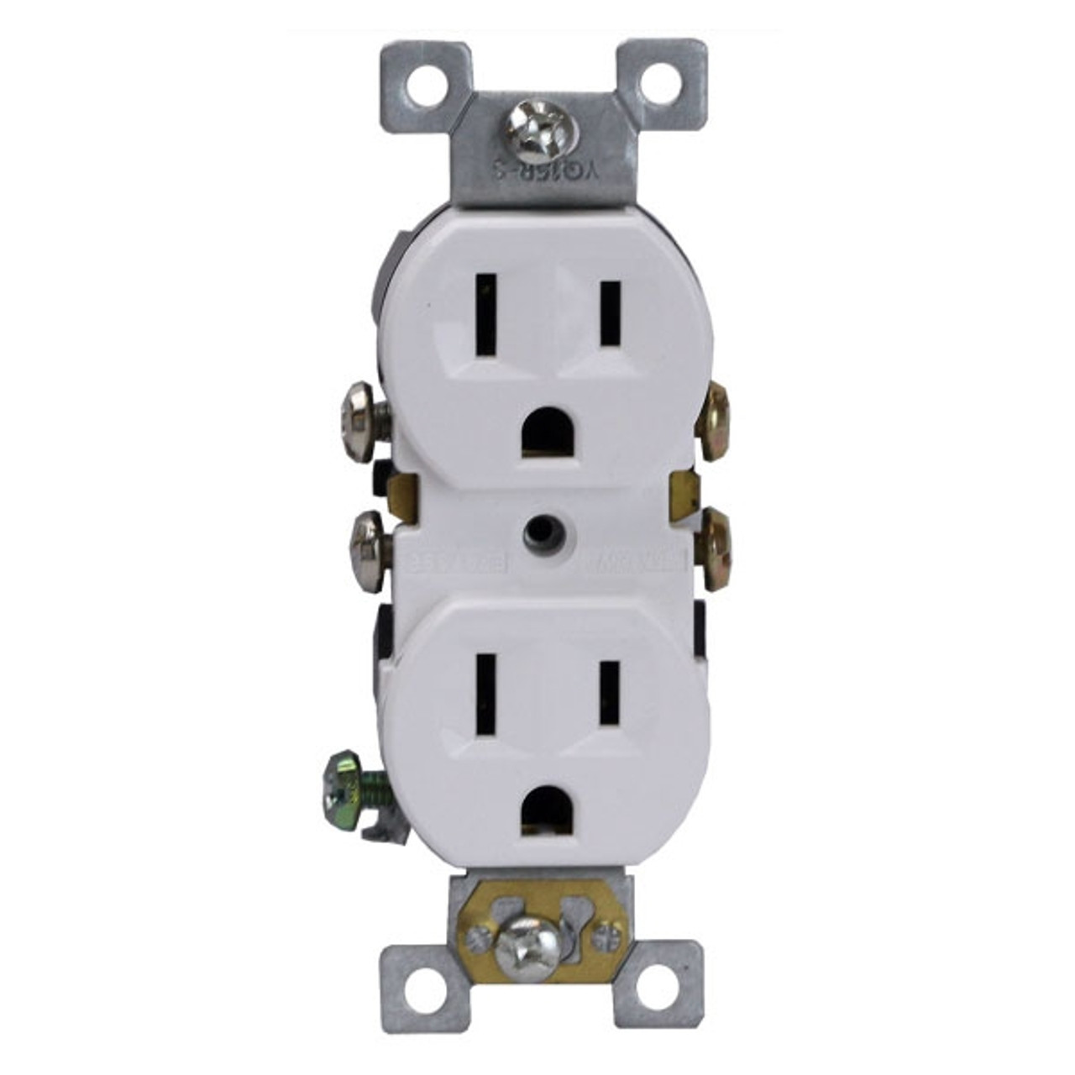
Scope Ground = AC Ground (for plug-in scopes)
Careful where you attach the alligator clip
GND
GND
GND
GND

Slide 17
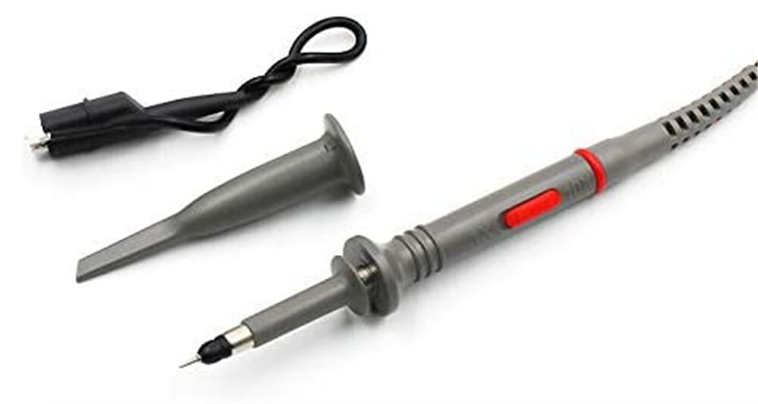
Probe tip shroud
GND

